Slide 1
Pithub
BearDown

Slide 2

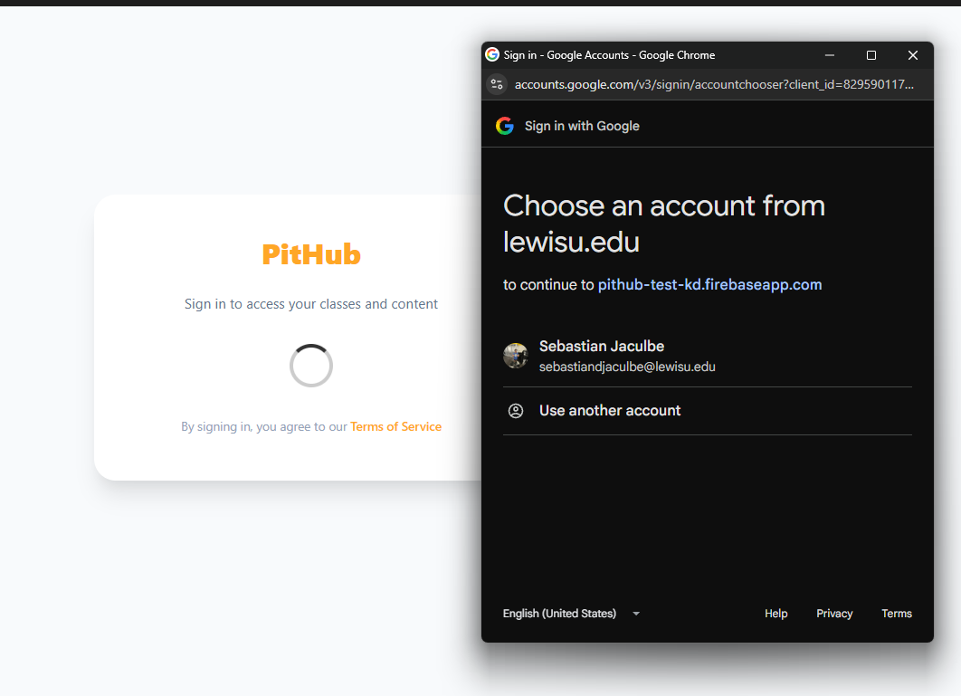
User Accounts and Authentication
Users can create their own account through their Lewis University email.
They can securely log in and log out.
They remain logged in throughout their session.

Slide 3
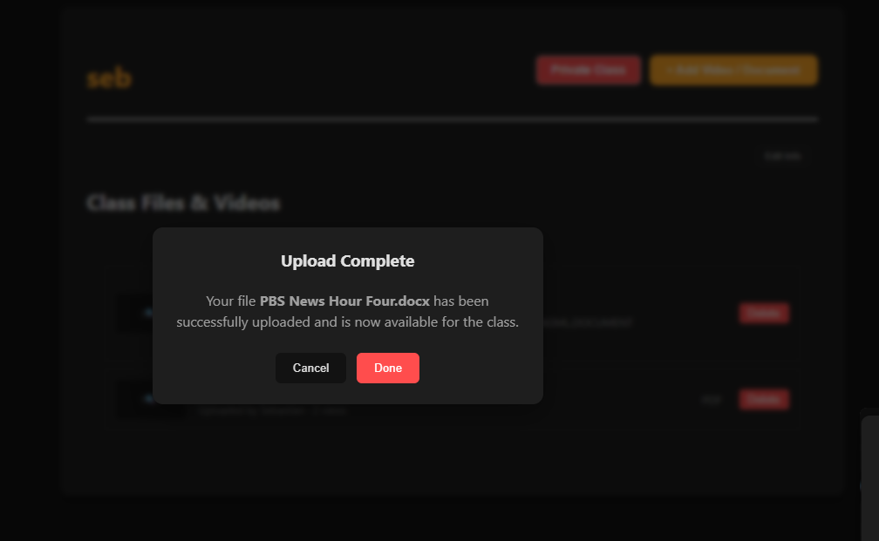
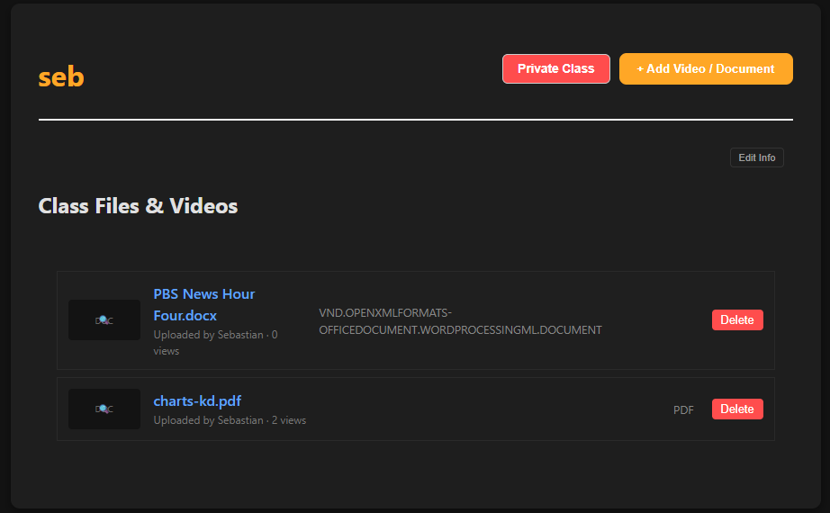
Video Uploading and Management
Users can upload videos and receive feedback when uploads succeed or fail.
They can also delete videos and receive confirmation before deletion.

Slide 4
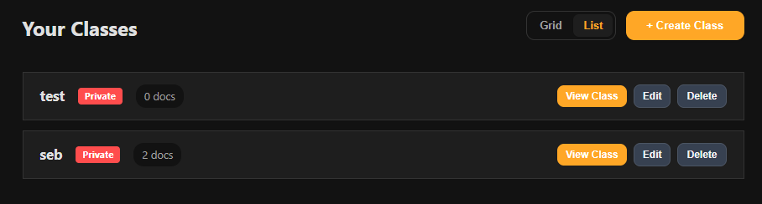
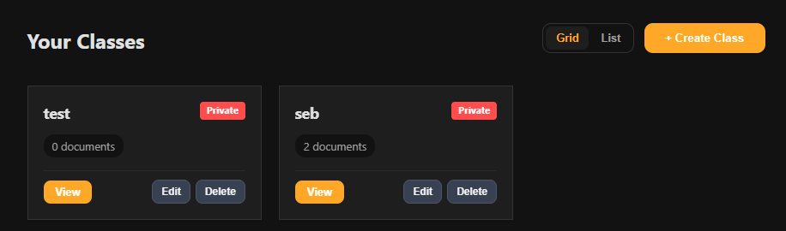
Classes and Course Organization
Users can create classes, assign videos to classes, organize videos by course/professor/school year/date, view videos within a class, and delete classes.

Slide 5
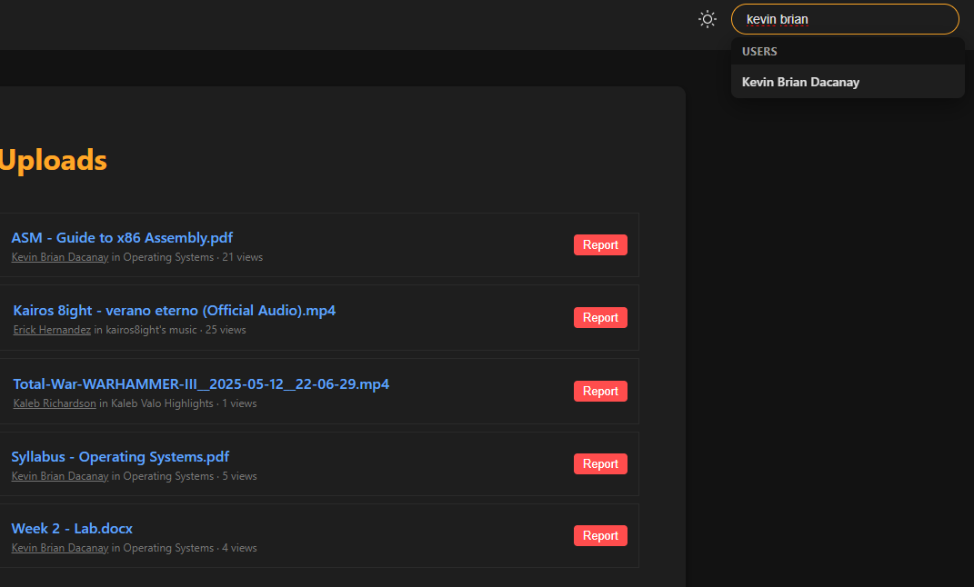
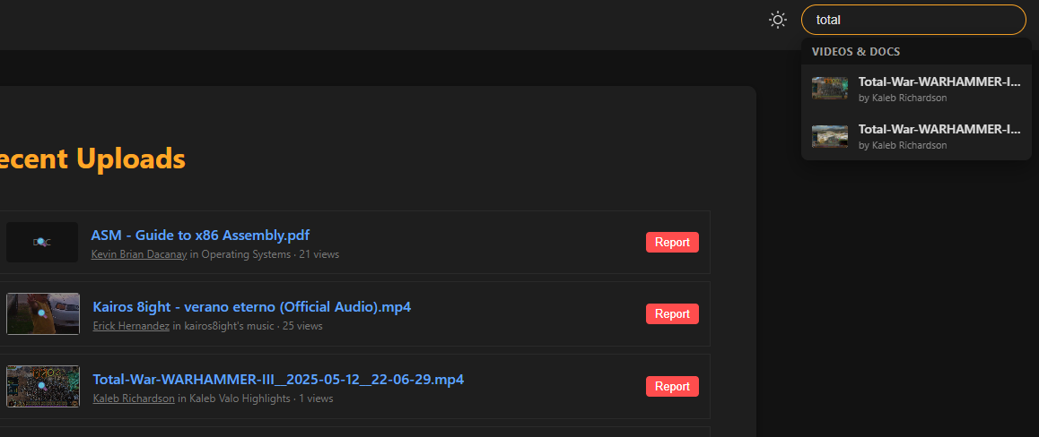
Search and Content Discovery
Users can search for videos, classes, and other users, making it easier to find relevant educational content posted by other users.

Slide 6
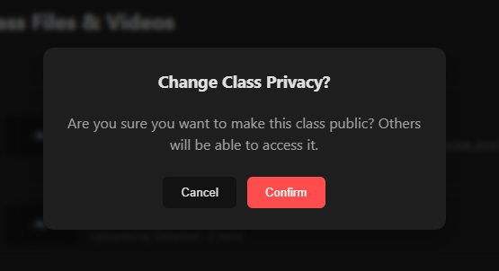
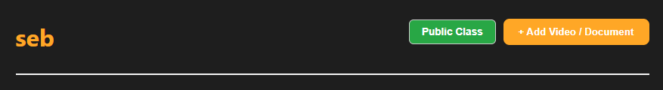
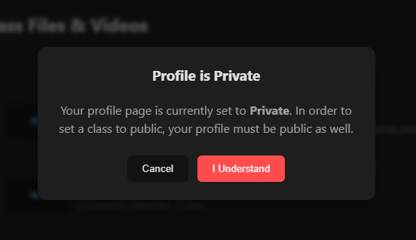
Public/Private Content and User profiles
Users can control the privacy of their videos: public or private.
They can see who uploaded content.
They are able to navigate to another user's profile to view their content, if set to public.

